Slide 1
Ch-ch-ch-ch-Changes to Reporting Requirements
Turn and Face the Strange
John Dillard | www.threatswitch.com | jdillard@threatswitch.com
Notes:
Thank Hosts for Invitation
Share premise:

Slide 2
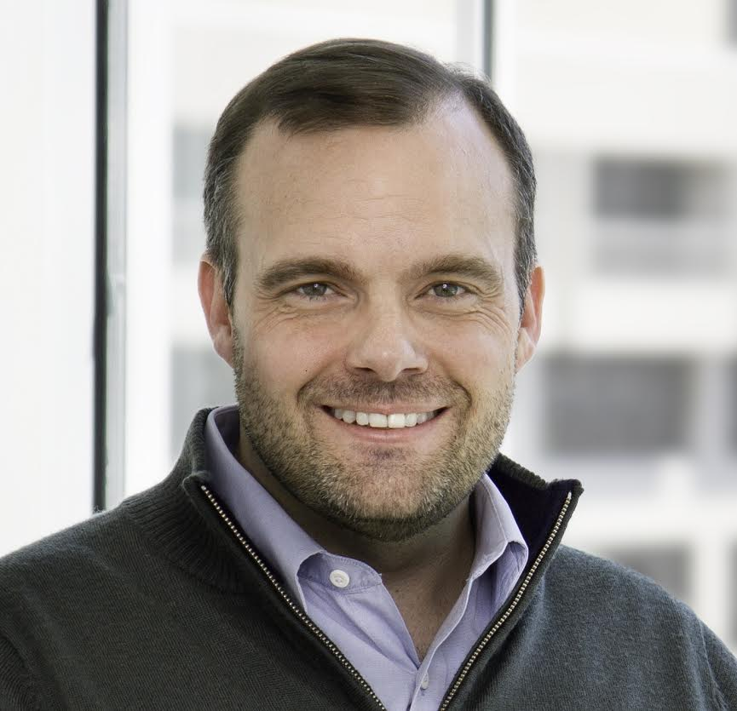
About John
CIA; Navy; SRA Executive; RANE Expert; Founder of 2 Security Companies
Former FSO and US Navy Security Manager
Currently CEO of ThreatSwitch, focused on software to help cleared federal contractors
Notes:
Story:
Never forget -- date – ensign, security violation.

Slide 3
What you’ll get out of this
The ingredients of a reporting engine that will make our lives easier
02
The changing reporting requirements that make our lives harder
01
Notes:
Two things I want you to take away:
RR themselves. What’s has changed recently, and what’s coming
Give you some tools to adapt on a fundamental level, because it’s not about the reporting itself.

Slide 4
Existing
New
Coming Soon
Notes:
I’m going to walk through a few things at a high level:
Esiting – stuff you should already be doing but may not be;
Things that are in flux right now
Things that are coming
You will notice a pattern. These things come in two shots – first the guidance, then followed by verification. So it actually feels like two changes.

Slide 5
Existing
New
Coming Soon
Notes:
Here’s what we’ll be talking about

Slide 6



First, the obvious stuff.
The Terribles. Espionage, sabotage, terrorism, and subversive activities
Adverse. Based on the adjudicative guidelines.
Suspicious Contacts. Sketchy characters; not just foreign nationals.
Notes:
FOR EACH:
Here's what it is
Why it matters
What you need to do

Slide 7
The Thirteen
A: Allegiance to the U.S.
B: Foreign Influence
C: Foreign Preference
D: Sexual Behavior
E: Personal Conduct
F: Financial Considerations
G: Alcohol Consumption
H: Drug Involvement
I: Psychological Conditions
J: Criminal Conduct
K: Protected Information
L: Outside Activities
M: Information Technology
Notes:
FOR EACH:
Here's what it is
Why it matters
What you need to do

Slide 8
Existing
New
Coming Soon
Notes:
Here’s what we’ll be talking about

Slide 9
“New” isn’t new anymore.
Insider threat (versions 1 & 2). Your company is responsible, not your customer.
SEAD 3. Massive increase in requirements, especially foreign travel and contacts.
CUI/NIST/DFARS. What do you have and how do you protect it?
Notes:
FOR EACH:
Here's what it is
Why it matters
What you need to do

Slide 10

Insider Threat (versions 1 & 2)
Gather, integrate, and report relevant information across the facility
Procedures to access, share, compile, identify, and collaborate
Patterns of negligence or carelessness
New ISL further clarifies and sets stage for enforcement

Slide 11

SEAD 3 (Underway)
“Covered Individuals” must report:
Actions by others
All unofficial travel – before the trip
All foreign contacts
Extends reporting requirements to Secret and non-critical sensitive positions

Slide 12

CUI / NIST 800-171 / DFARS
Reporting indicators of insider threat
Unlawful, unauthorized, or inappropriate IS activity
Investigation and response
Cyber Incidents
Information system flaws
Audit records and retention

Slide 13
Existing
New
Coming Soon
Notes:
Here’s what we’ll be talking about

Slide 14
New Reporting Requirements
Cybersecurity Maturity Model Certification (CMMC) Draft released September 4, 2019
SEAD 3 ISL dramatically increases the scope and who must report information.
RISO (Risk Based Industrial Security Oversight) requires more reporting on insider threat and risk-based criteria.
Notes:
FOR EACH:
Here's what it is
Why it matters
What you need to do

Slide 15

CMMC
Cybersecurity Maturity Model Certification
Focused on DIB companies and their supply chains
Primarily policy and process, NOT technical
Enforced at the contract level
18 domains with 5 levels of maturity
In the “expectation setting stage” and likely will not be enforced until mid-2020

Slide 16

Risk-based Industrial Security Oversight
Formerly DSS in Transition
Comprehensive Security Review (CSR)
The main effect of DSS in Transition
Reporting your assets
Reporting based on your assets

Slide 17

The SEAD 3 ISL Is Coming
Will direct compliance with CC3 including SEAD 3
“Covered Individuals” = anyone with any access (C, S, TS, SCI)
Clarifications provided that are specific to industry
All Foreign Travel for all covered individuals
Reportable actions by others
https://www.dni.gov/index.php/ncsc-how-we-work/ncsc-security-executive-agent/ncsc-policy

Slide 18

Bonus Requirement: The 4th Pillar
Security evaluated on par with cost, schedule, and performance in acquisition
Beyond NISPOM, including CUI, cybersecurity (including pending maturity model), supply chain
Makes COs another evaluator of security performance
May require ongoing communication with COs

Slide 19

Turn and face the strange
Notes:
So this is a story about change. (Bowie).
Stuff didn’t change much for a lon time, but now it changes constantly.

Slide 20








Building a reporting engine
Unfettered
Communication
Psychological Safety
Notes:
What do I mean by collaboration? It’s not just “talking more.” It’s not “working together.”
There are two absolutely crucial components of security collaboration: 1. Unfettered communication and 2. Psychological Safety.

Slide 21
First, Eliminate Friction
In security, unfettered communication means minimizing barriers to communicating about assets, threats, and vulnerabilities.
Every step, form, hassle, hoop, regulation, or delay reduces collaboration and increases risk.
Unfettered
Communication
Notes:
Unfettered communication means removing anything that slows down, blocks, or otherwise impedes communication. Between you and your colleagues, you and your executive team, you and your employees.
In a perfect world, everyone knows about reportable information as soon as it happens. We need forms, meetings, etc to collect that information, of course, but the harder those are to use, the less likely they are to use.
How to fix this? Use (good) technology. Eliminate redundant steps. Reduce worry and pressure. Don’t wait 30 days to have an insider threat working group meeting.

Slide 22
Unfettering 101: People
The first step in unfettering your communication is about people: who are you collaborating with, and how?
Employees
Peers
DSS
IC Customers
Contracting Officers
Executives
Primes, Vendors and Subs
Unfettered
Communication
Notes:
The first part of unfettering is understanding the people you need to collaborate with and identifying – for each – what is impeding collaboration and creating friction. Is it frequency? Method? Language? Knowledge? Time?

Slide 23
Unfettering 101: Process
The second step in unfettering your communication requires triaging your process.
What are the steps in each collaboration process?
Which steps can be eliminated?
Which steps can be optimized?
Unfettered
Communication
Notes:
The first part of unfettering is understanding the people you need to collaborate with and identifying – for each – what is impeding collaboration and creating friction. Is it frequency? Method? Language? Knowledge? Time?

Slide 24
Unfettering 101: Technology
Finally, the complexity of today’s security program makes using the right technology critical.
Do our tools:
Centralize information?
Automate workflows?
Allow collaboration?
Accessible everywhere?
Include everyone?
Unfettered
Communication
Notes:
Tell the story about building threatswitch.

Slide 25
Second, Make it Safe
In security, psychological safety means maximizing trust.
Collaborator, not adversary
“Just like me”
Anticipate reactions
Curiosity, not blame
Ask for feedback
Measure safety
Psychological Safety
Notes:
Psychological safety is the 2nd part of collaboration. That means that the communicating parties enjoy mutual trust.
These 6 points taken from research performed by Google – who determined that the single most important factor in team success is Psychological Safety. https://hbr.org/2017/08/high-performing-teams-need-psychological-safety-heres-how-to-create-it

Slide 26
Psychological Safety 101
Collaborator, not adversary
Everyone hates losing, so don’t turn anyone into a loser.
Psychological Safety
Notes:
Psychological safety is the 2nd part of collaboration. That means that the communicating parties enjoy mutual trust.
These 6 points taken from research performed by Google – who determined that the single most important factor in team success is Psychological Safety. https://hbr.org/2017/08/high-performing-teams-need-psychological-safety-heres-how-to-create-it

Slide 27
Psychological Safety 101
Just Like Me
Speak human to human.
Psychological Safety
Notes:
Psychological safety is the 2nd part of collaboration. That means that the communicating parties enjoy mutual trust.
These 6 points taken from research performed by Google – who determined that the single most important factor in team success is Psychological Safety. https://hbr.org/2017/08/high-performing-teams-need-psychological-safety-heres-how-to-create-it

Slide 28
Psychological Safety 101
Anticipate reactions
What are my main points?
How will they respond?
How will I respond to each of those scenarios?
Psychological Safety
Notes:
Psychological safety is the 2nd part of collaboration. That means that the communicating parties enjoy mutual trust.
These 6 points taken from research performed by Google – who determined that the single most important factor in team success is Psychological Safety. https://hbr.org/2017/08/high-performing-teams-need-psychological-safety-heres-how-to-create-it

Slide 29
Psychological Safety 101
Curiosity, not blame
Do not become someone else’s saber-toothed tiger
Psychological Safety
Notes:
Psychological safety is the 2nd part of collaboration. That means that the communicating parties enjoy mutual trust.
These 6 points taken from research performed by Google – who determined that the single most important factor in team success is Psychological Safety. https://hbr.org/2017/08/high-performing-teams-need-psychological-safety-heres-how-to-create-it

Slide 30
Psychological Safety 101
Ask for feedback and measure safety
Ask individuals right away and use simple surveys
Psychological Safety
Notes:
Psychological safety is the 2nd part of collaboration. That means that the communicating parties enjoy mutual trust.
These 6 points taken from research performed by Google – who determined that the single most important factor in team success is Psychological Safety. https://hbr.org/2017/08/high-performing-teams-need-psychological-safety-heres-how-to-create-it

Slide 31
Resources for Download
Draft release of Cybersecurity Capability Maturity Model
Webinar on Comprehensive Security Reviews
CDSE Job Aid on Adverse Reporting
CDSE Course Materials on Reporting Requirements
DNI SEAD 3 Frequently Asked Questions
DFARS CUI/NIST 800-171 Implementation Brief
-or-
https://www.threatswitch.com/reporting-requirements-resources

Slide 32
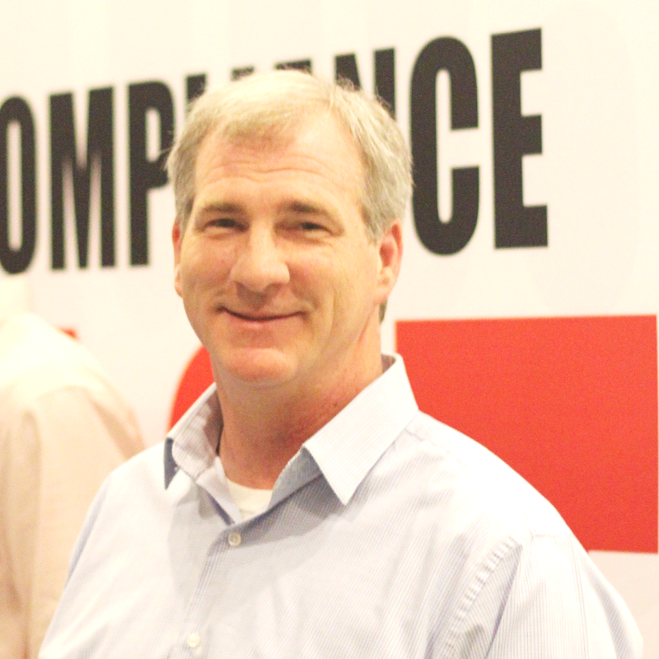
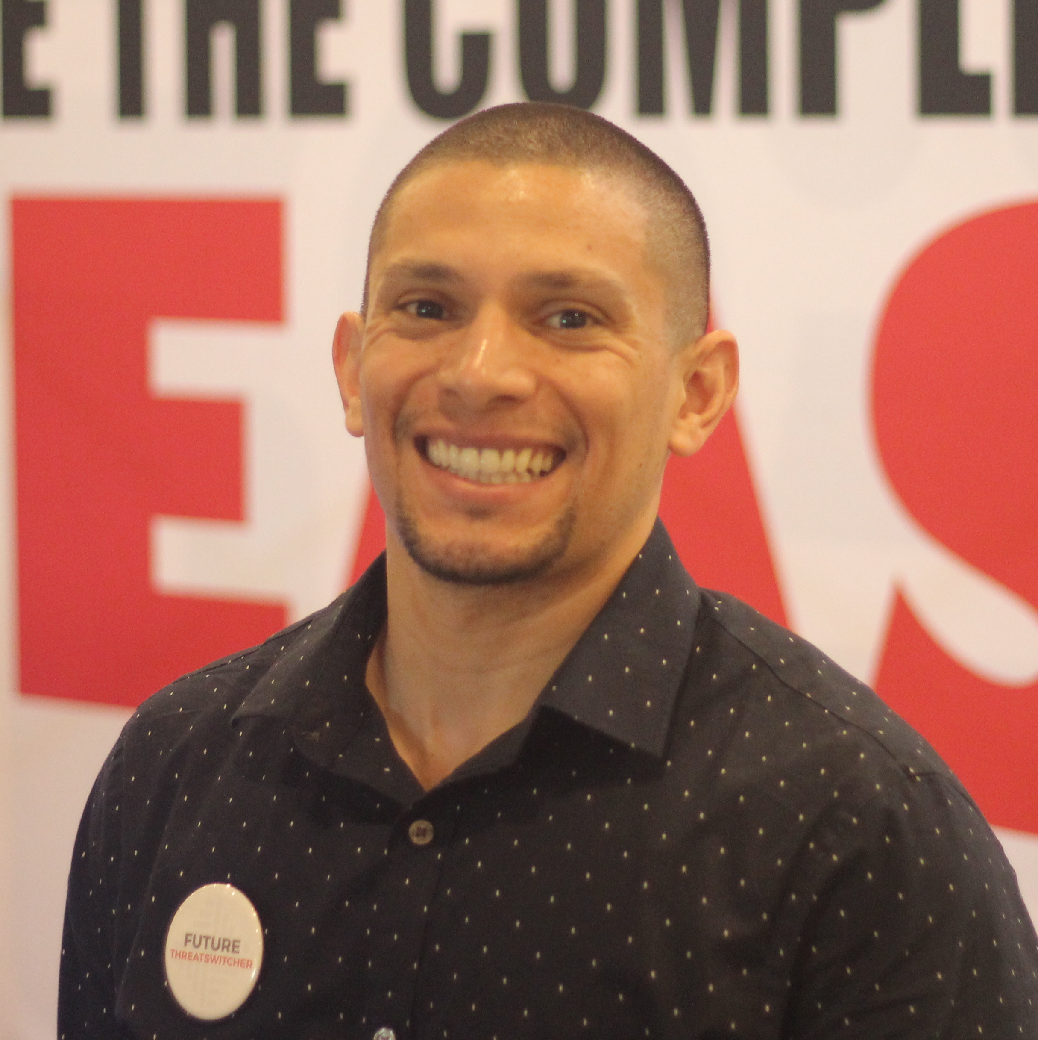

ThreatSwitch Team
Brian Page
brian@threatswitch.com
Jeff Zelaya
jeff@threatswitch.com
Kaitlin Fadule
kaitlin@threatswitch.com
ThreatSwitch’s software solution helps cleared federal contractors
get and stay compliant with NISPOM and related security regulations.
Notes:
We have a team here, so please stop by with any questions. And while you’re at our table, we’ll donate $5 to VetDogs in exchange for your business card.

Slide 33


Parting Thoughts
Understand Changes
Reporting Engine
Turn and Face the Strange

Slide 34
www.threatswitch.com
We write about this stuff all the time. For more resources, visit our website www.threatswitch.com/resources

